Slide 1
Hallucination detection in DTG
Final Project Discussion
Sumit Jain, 190050119
Akshay Iyer, 190070006
Adit Akarsh, 19D070003
Prateek Neema, 20D070061 10/03/2023

Slide 2
Problem Statement
We wish to detect and control hallucinations in natural language generation, when using data from a certain data source. This is very important today, since models like ChatGPT are being used extensively, yet are not very reliable for accurate information.
We are focusing on models that generate textual information from tabular data.

Slide 3
Input Output Description:
The input training date is in the form of data tables along with some natural language text, for example the Wikipedia bio table which contains a set of key-value pairs.
For test input, the natural language part from the input is removed.
The output is in the form of sentences generated about the entity with focus on coverage (being able to cover all the information) and adequacy (not using any information not present)

Slide 4
Related works
Mention some of the recent published/arxiv works related to your problem statement
Controlling Hallucinations at Word Level in Data-to-Text Generation
Survey of Hallucination in Natural Language Generation
Detecting Hallucinated Content in Conditional Neural Sequence Generation

Slide 5
Dataset (s)
WikiBio - 728, 321 tables
paired with the first sentence of the corresponding Wikipedia English article
Average length - 26 words
12 key-value pairs on average
WebNLG - Triplets of text containing facts about entities, analogous to tabular data (context | key | value)

Slide 6
PreProcessing
WikiBio:
Separating title, reference text (first paragraph of wikipedia page), and normalizing (using parentheses instead of -LRB, -RRB)
WebNLG:
Reading triplets of text (context, key, value), concatenating them

Slide 7
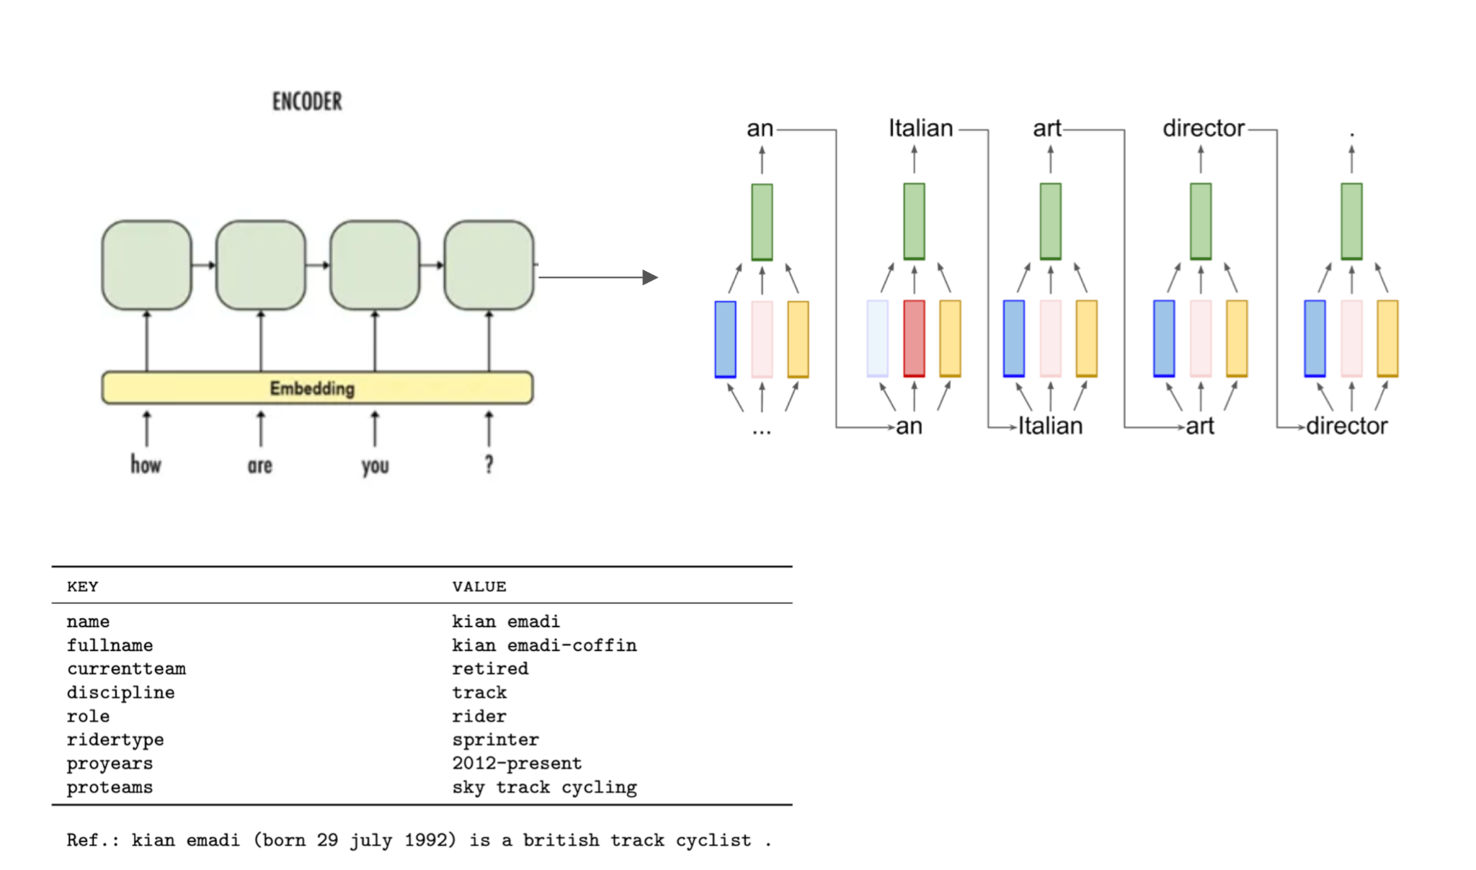
Workflow, Architecture, Technique
Current model is an encoder decoder with attention.
Three different decoder RNNs that have a weighted sum to give the net decoder state.
Three weights for content, hallucination and fluency.
Dynamic weight assignment for the three decoder RNNs during training. Manual, controllable and fixed weights during inference.
More manual hallucination, less content implies more emphasis on diversity than accuracy.

Slide 8
Results and Analysis
The model is able to generate simple sentences for small tables.
Examples (Title | Key | Value && Title | Key | Value ) -
Input: Frederick Parker | Born | 21 November 1914, Newington, Yorkshire && Frederick Parker | Died | 2 March 1987 (Aged 72)
Reference Sentence: Frederick Parker was born on 21 November 1914 in NewingTon, Yorkshire and died on 2 March 1987 (Aged 72).
Output: Born in 1914, Newington, Yorkshire, Frederick Parker died in the 2nd of March 1987.
BLEU: [0.1557426959121525, 6.891877067555892e-104]
Input: John_E_Blaha | birthDate | 1942_08_26 && John_E_Blaha | birthPlace | San_Antonio && John_E_Blaha | occupation Fighter_pilot
Reference Sentence: John E. Blaha was born on 26 August, 1942 in San Antonio. He was a fighter pilot.
Output: John E. Blaha was born in San Antonio on August 26, 1942. He was a fighter pilot.
BLEU: [0.6558559741464046, 0.5561931677135016]

Slide 9
Results and Analysis
Input: Harry Potter | Author | J.K. Rowling && Harry Potter | Country| United Kingdom && Harry Potter | Language | English && Genre | Fantasy
Reference: Harry Potter is a book series written by J.K. Rowling set in the United Kingdom. It is written in English and is of the fantasy genre
Output: Harry Potter is from the United Kingdom and was written by J.K. Rowling. The book is a fantasy genre and is written in English.
BLEU score: [0.5105799012536025, 0.3197998573510896]
Input: Indus Valley Civilisation| Alternative Names | Harappan civilization, ancient Indus, Indus civilization && Indus Valley Civilisation | Geographical range | Basins of the Indus river, Pakistan and the seasonal Ghaggar-Hakra river, northwest India and eastern Pakistan && Indus Valley Civilisation| Period | Bronze Age South Asia && Indus Valley Civilization | Dates | c. 3300 - c.1300 BCE
Reference: Indus Valley Civilisation, also known as the Harappan Civilization, the ancient Indus, or the Indus civilization was a bronze age South Asia civilization in the basins of the Indus river, Pakistan and the seasonal Ghaggar-Hakra river, northwest India and eastern Pakistan. It was active during the years c. 3300 - c.1300 BCE.
Output: The Indus Valley Civilisation (also known as Harappan civilization, ancient Indus civilization) has its c. 3300 - c.1300 BCE and its location is the Basin River, Pakistan and the regional Ghaggar-Hakra river, northwest India and eastern Pakistan.
BLEU score: [0.30893390472038984, 0.24409708126846064]

Slide 10
Results and Analysis
Points of failure:
The grammar is not completely accurate
Born in 1914, Newington, Yorkshire, Frederick Parker died in the 2nd of March 1987
The model does not seem to understand less frequently used words (e.g. ‘Reign’)
Elizabeth II was the Predecessor of Charles III, which was born on September 2022 and is now a member of the Reign.
Instead of “Elizabeth II was the Predecessor of Charles III, whose reign started in September 2022”

Slide 11
Demo
Input format : Title | Key | Value && Title | Key2 | Value2 && Title | Key3 | Value3

Slide 12
Evaluation Scheme
1. Attractive and complex problem: 5
2. Clarity in task and in input-output description: 5
3. Dataset effort- collection, annotation: 10
4. Workflow, Architecture, technique: 10
5. Results and analysis: 10
6. Demo working: 20

